Slide 1
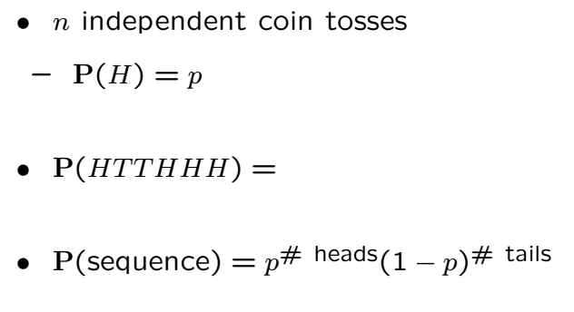
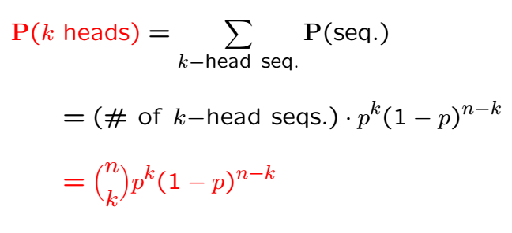
Binomial Probabilities

Slide 2
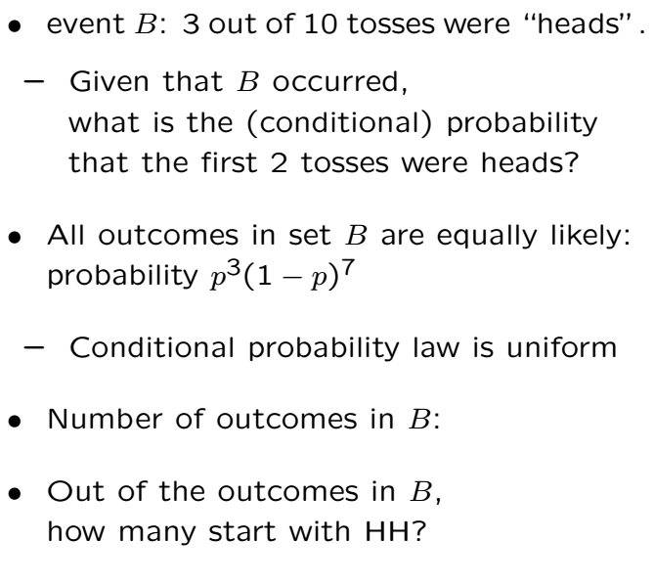
Example

Slide 4
Example (Repetition Code)
To communicate 1 we send 111
To communicate 0 we send 000
We receive 3 (possibly toggled) bits
Bits toggle with probability p independently
Receiver does majority combining
What is the probability that receiver is fooled?

Slide 5
Acknowledgements and Citations
Parts of these slides are adapted from the following resources:
Power Point Lecture Slides for the Textbook http://bcs.wiley.com/hebcs/Books?action=index&bcsId=8676&itemId=1118324560
John Tsitsiklis. 6.041 Probabilistic Systems Analysis and Applied Probability, Fall 2010. (Massachusetts Institute of Technology: MIT OpenCourseWare),http://ocw.mit.edu (Accessed 13 Apr, 2015). License: Creative Commons BY-NC-SA

